Slide 1
World Book Day
2024

Slide 2
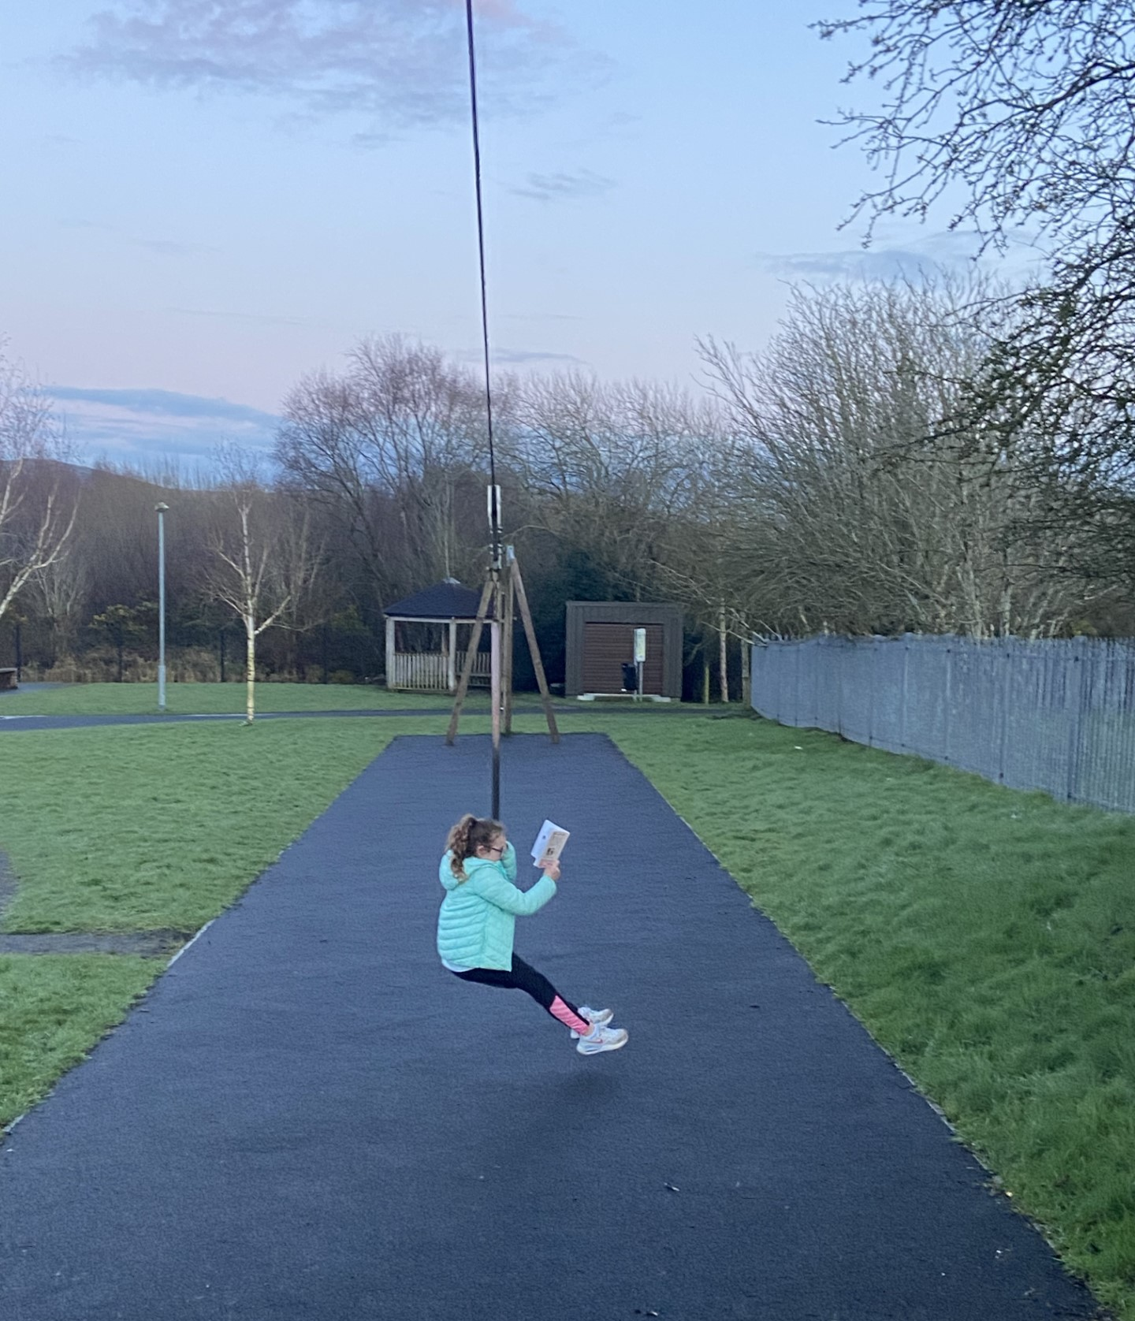
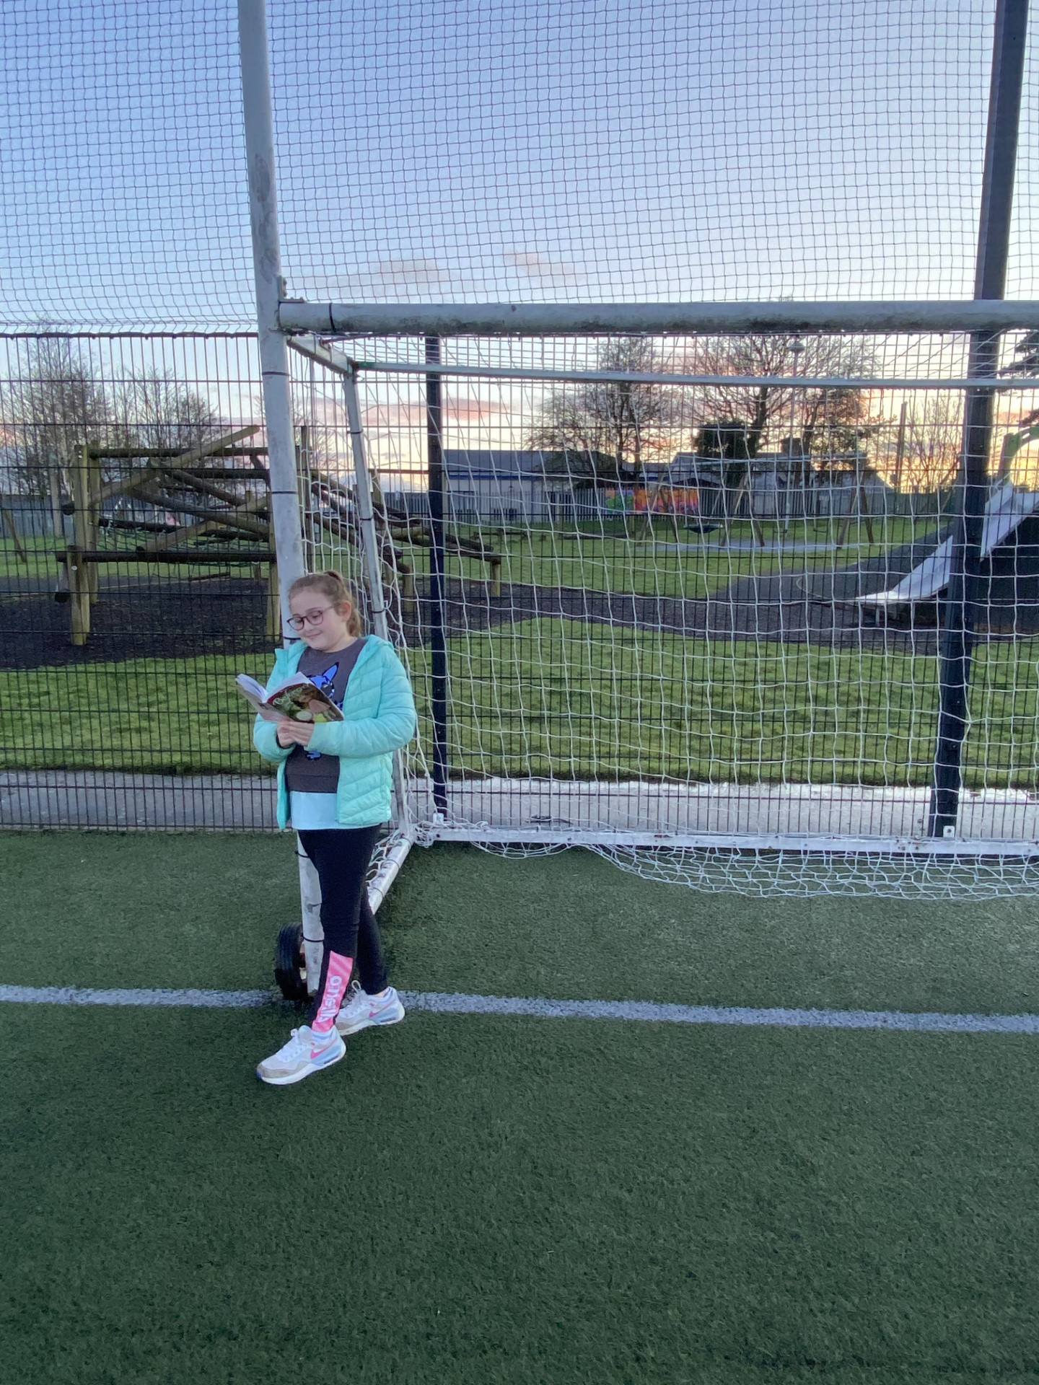
Where am I?
FamilyID=Office_ArchiveTorn

Slide 3
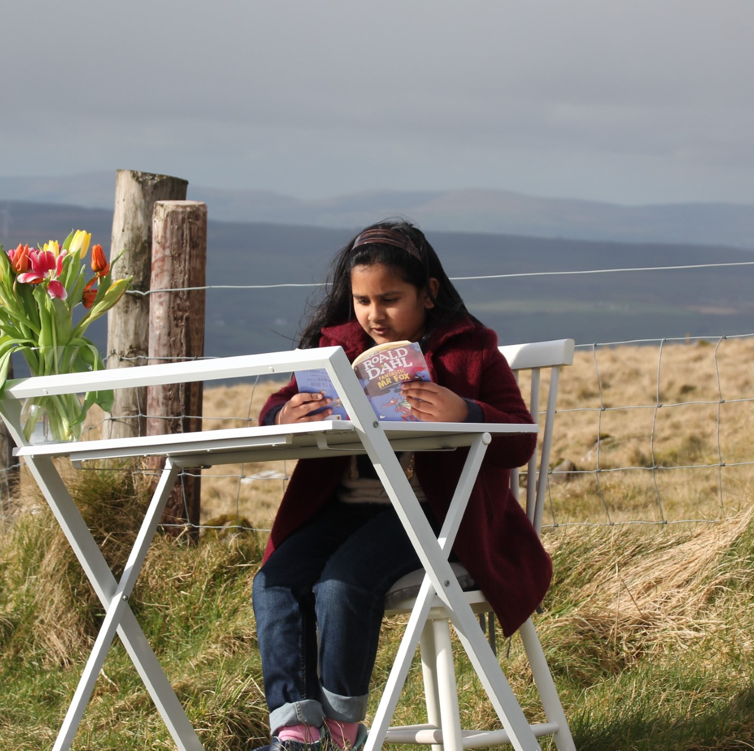
Where am I?

Slide 4
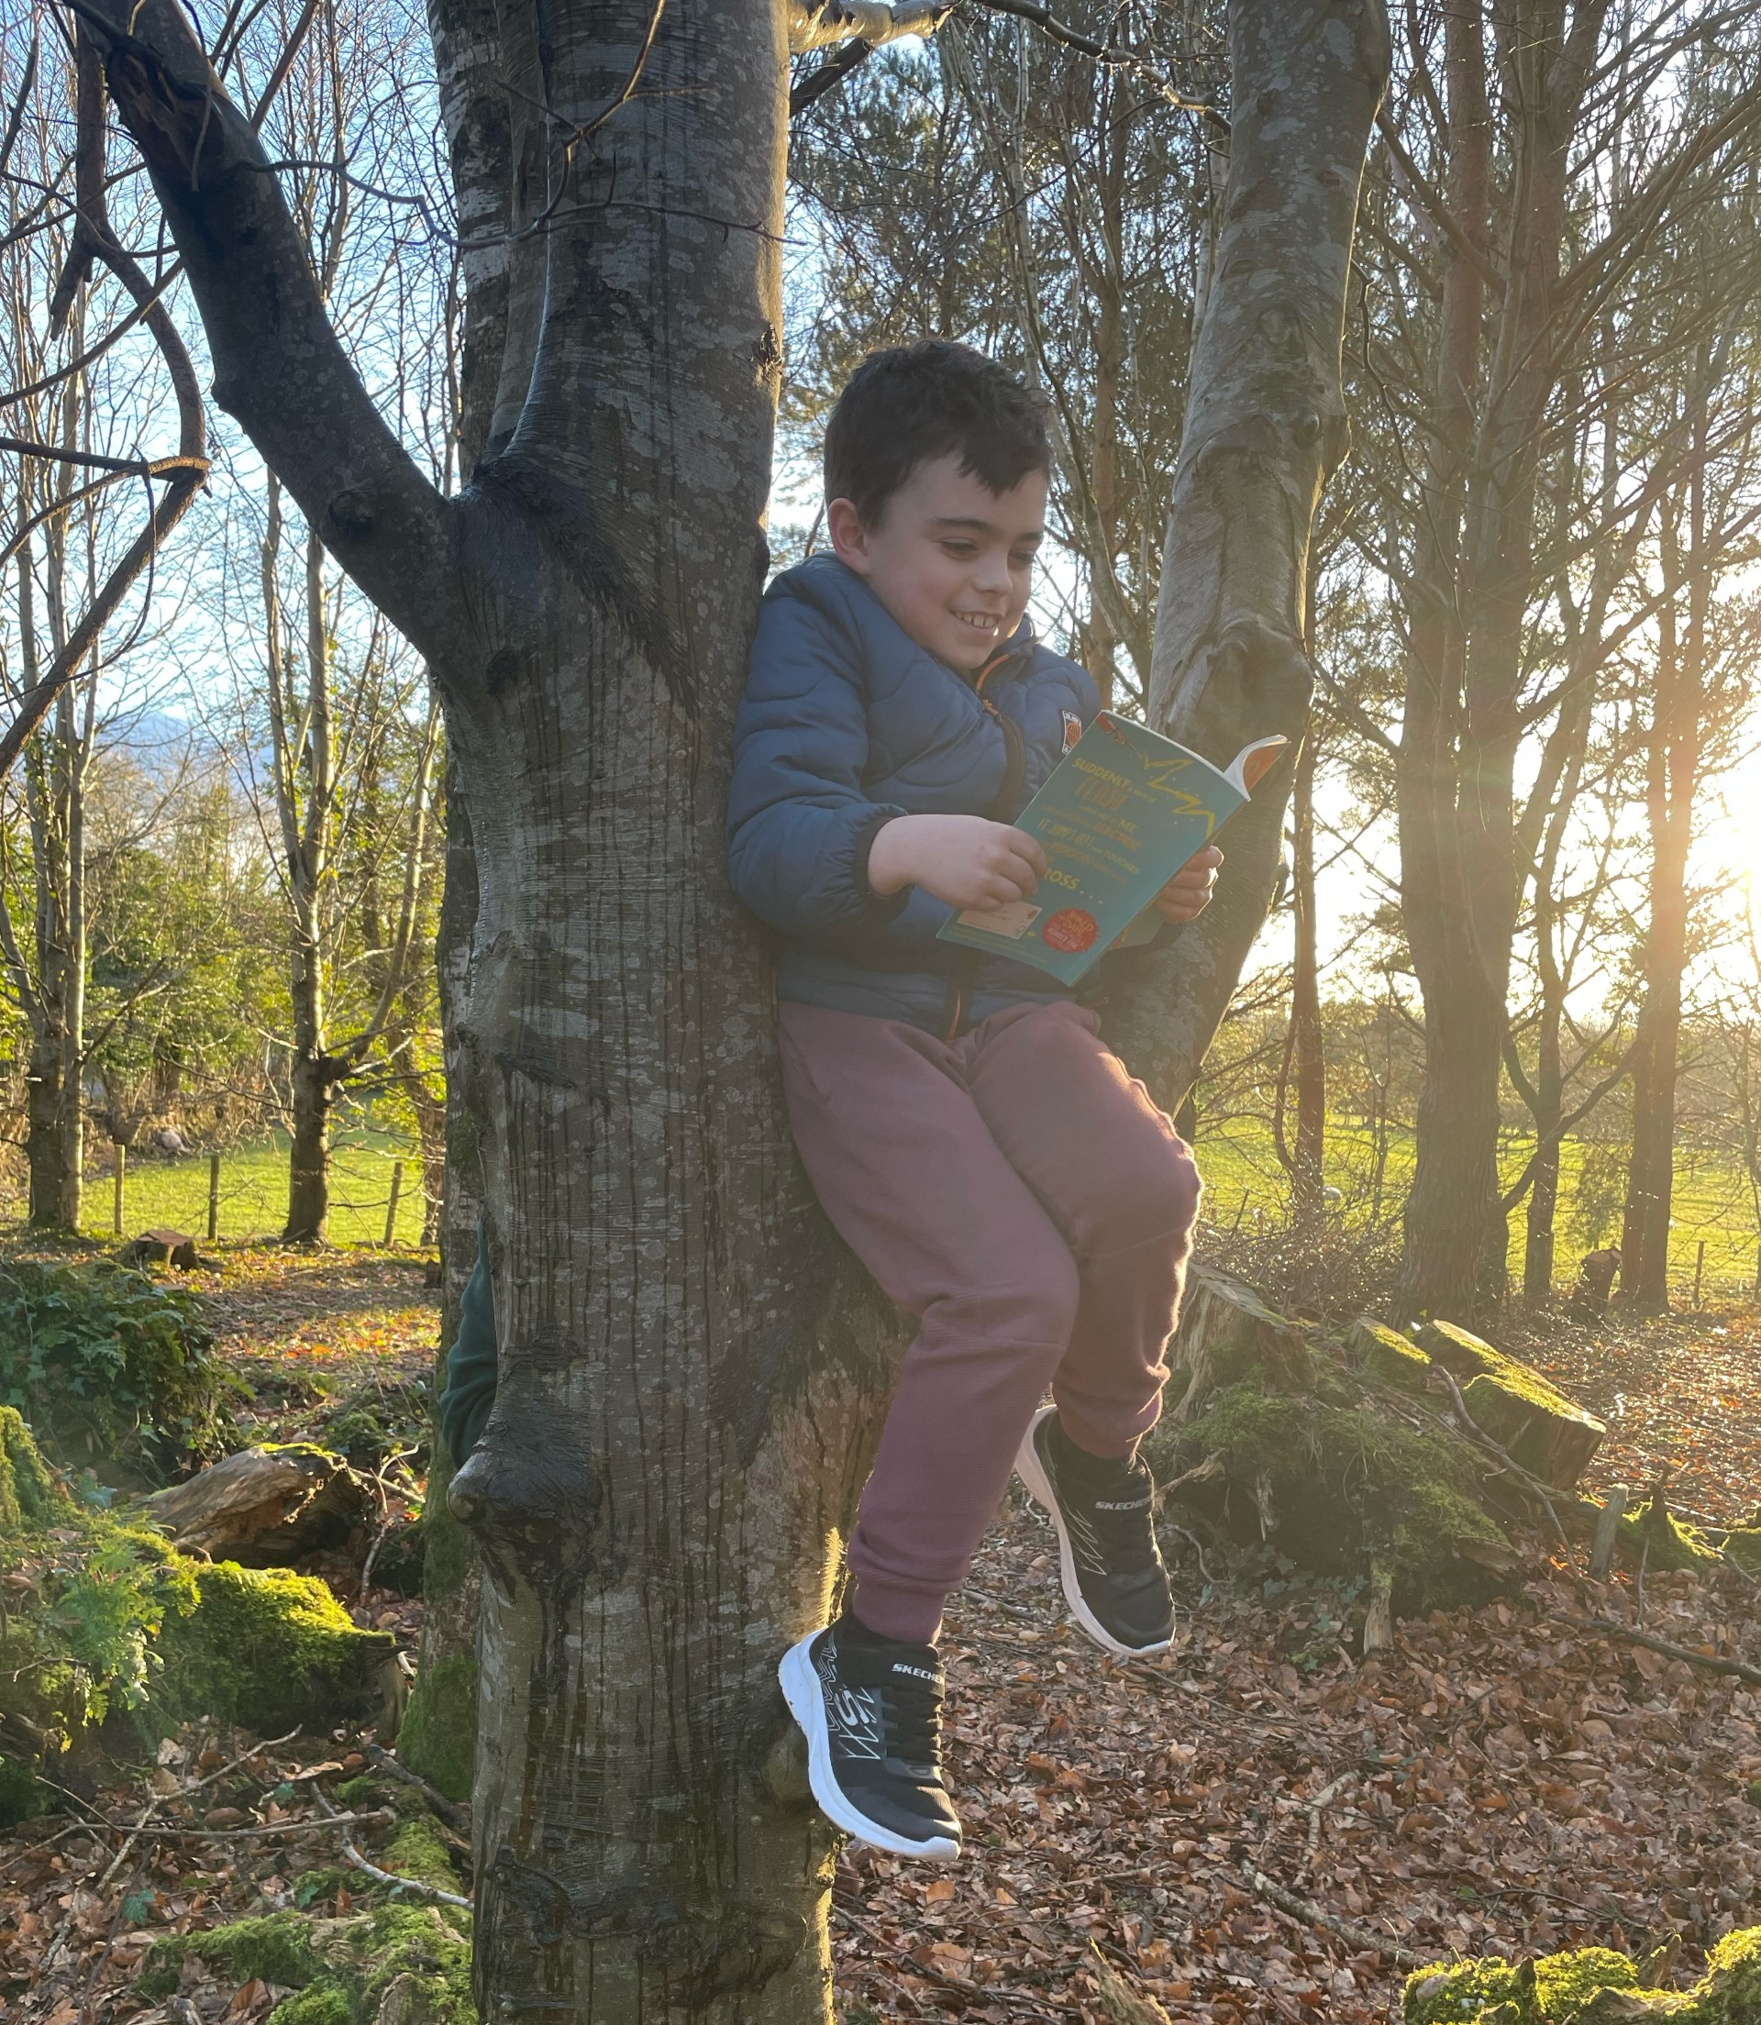
Where am I?

Slide 5
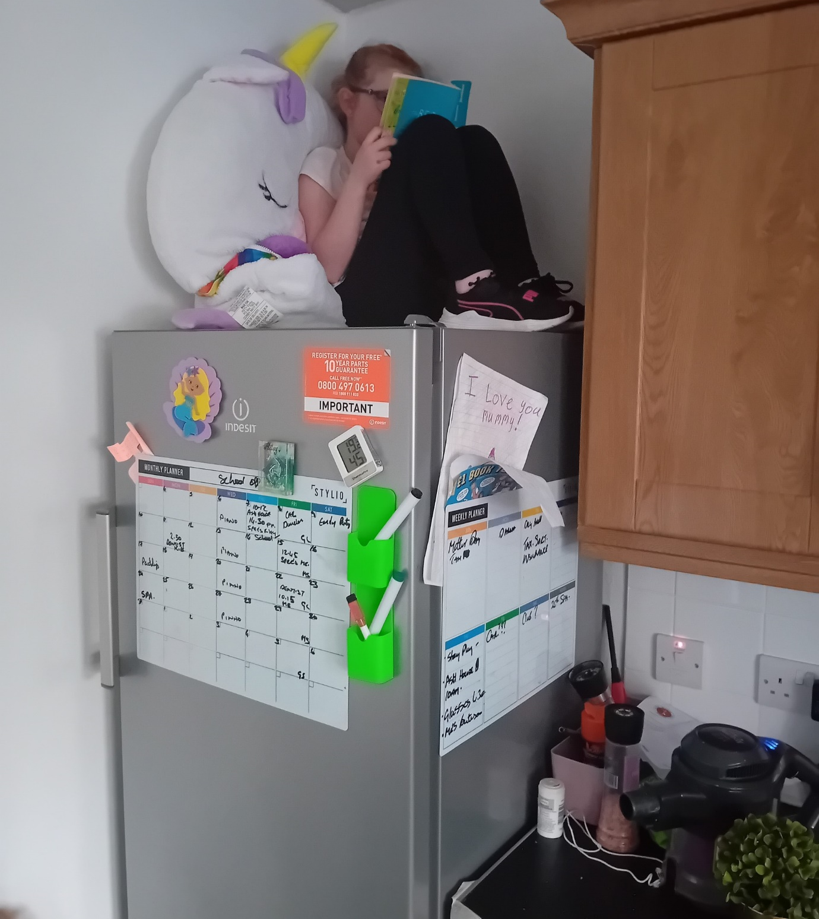
Where am I?

Slide 6
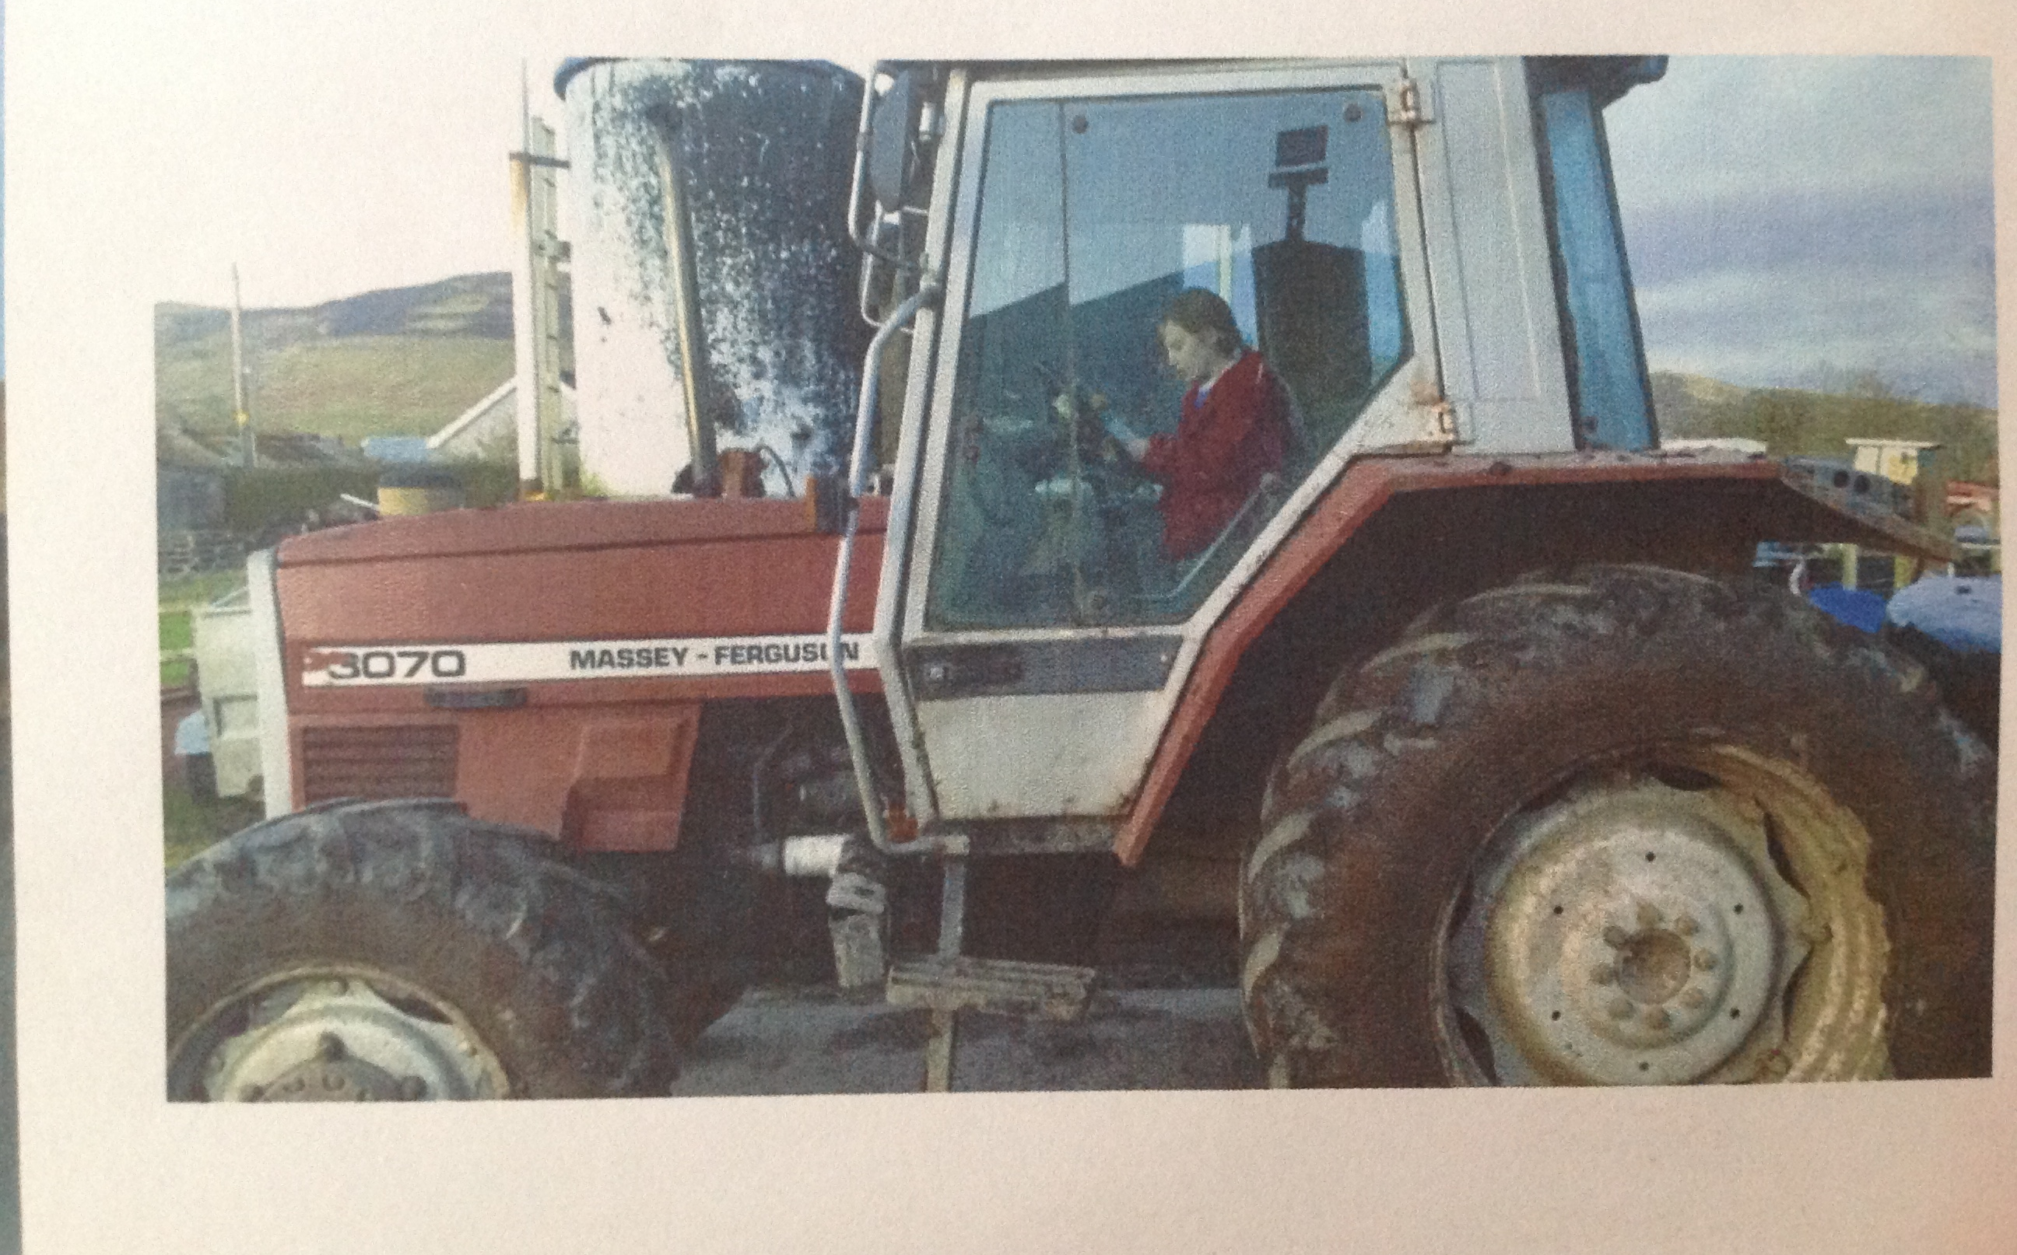
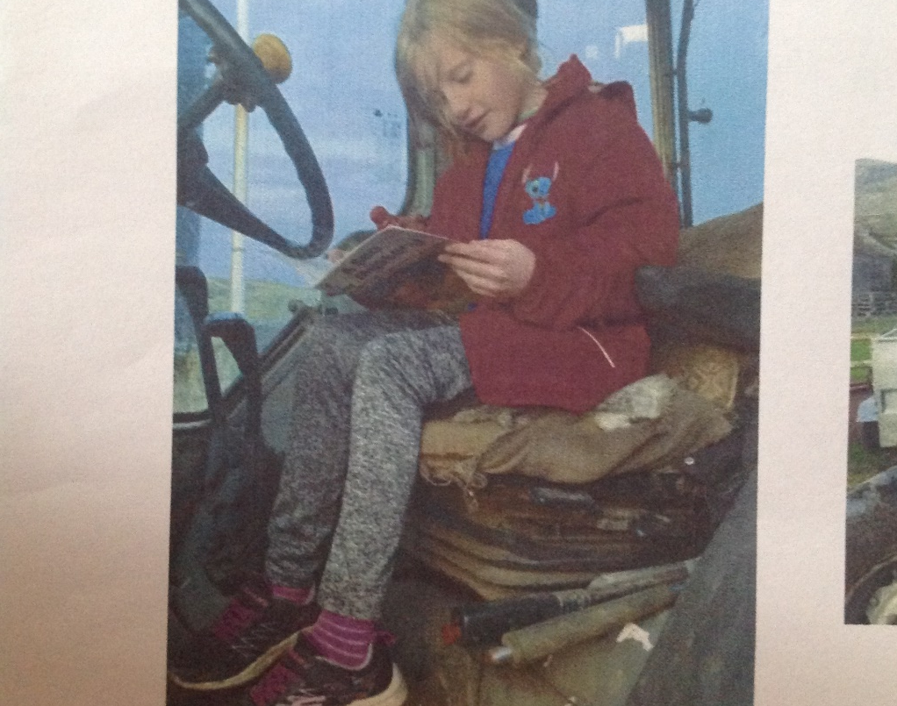
Where am I?

Slide 7
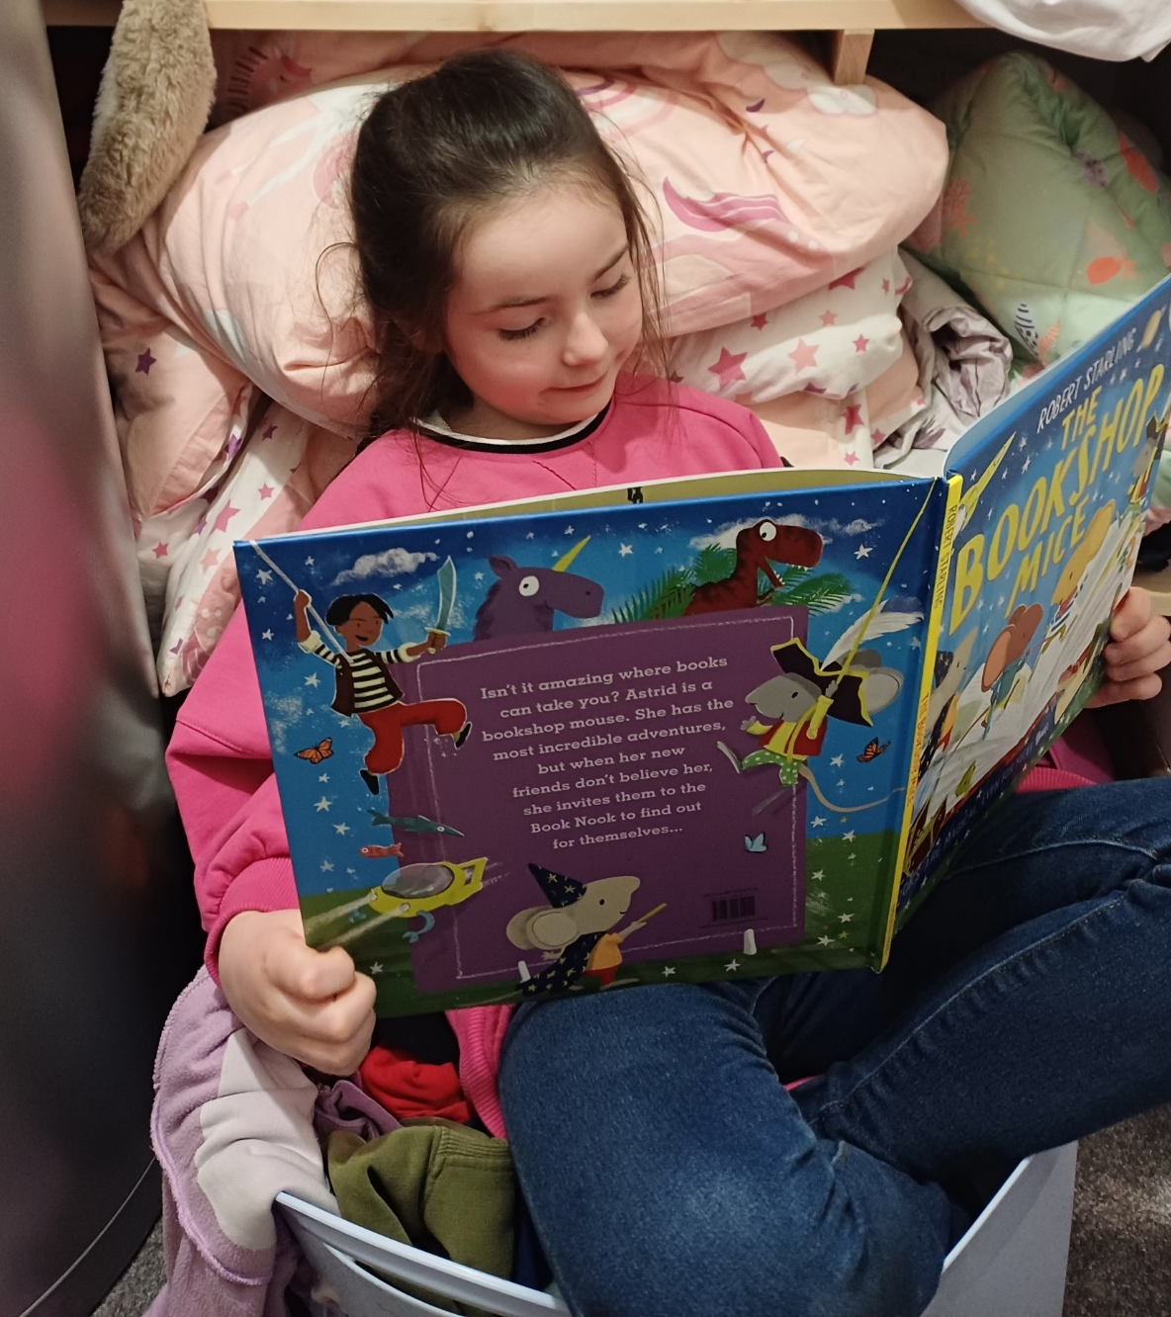
Where am I?

Slide 8
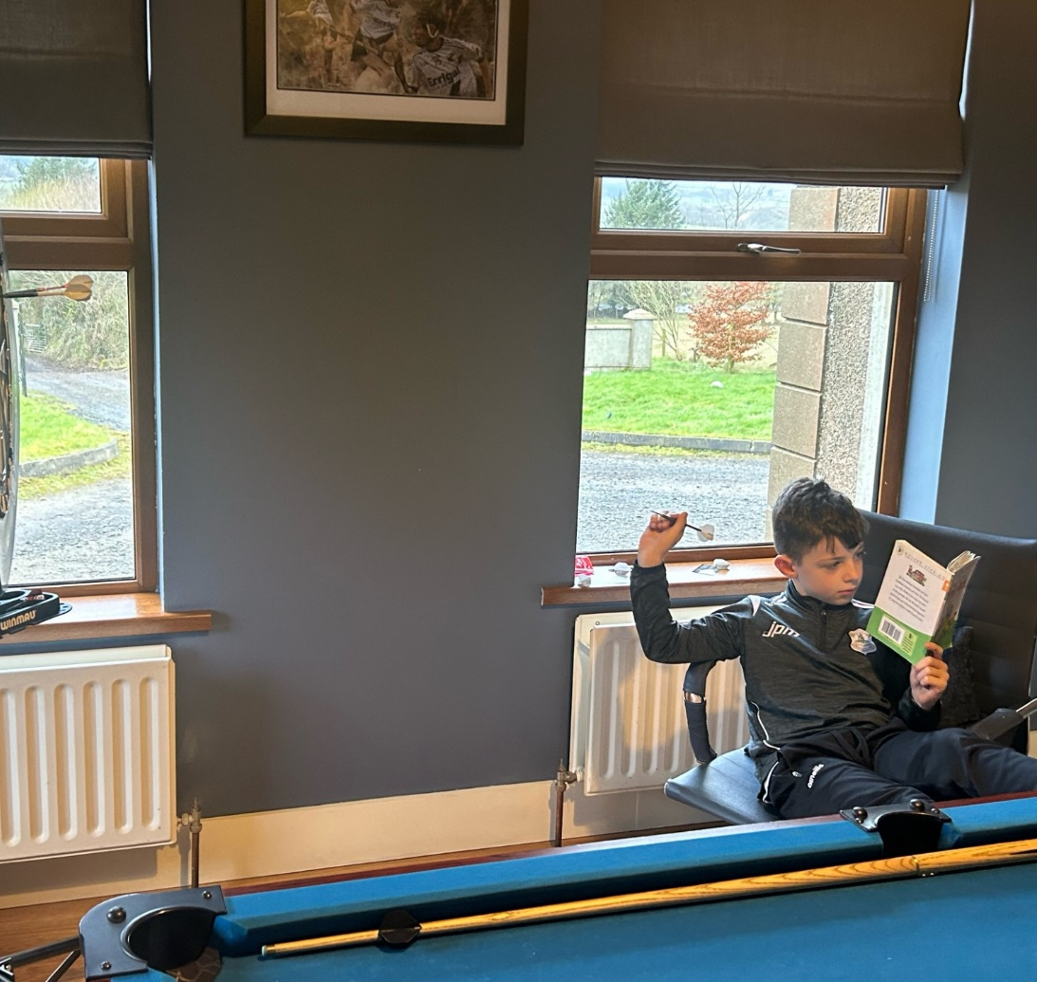
Where am I?

Slide 9
Where am I?

Slide 10
Where am I?

Slide 11
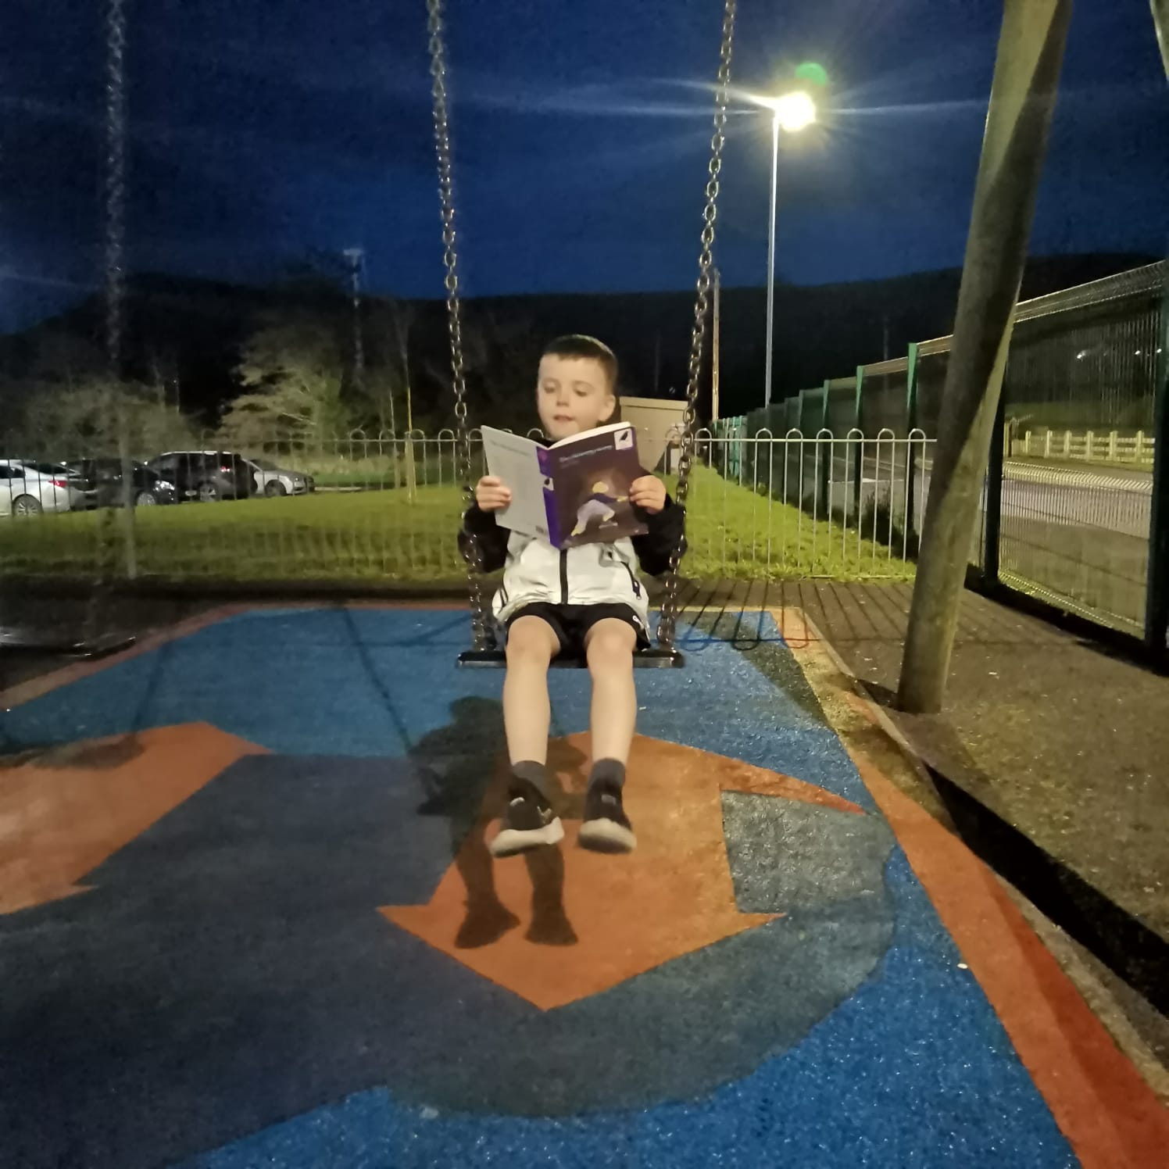
Where am I?

Slide 12
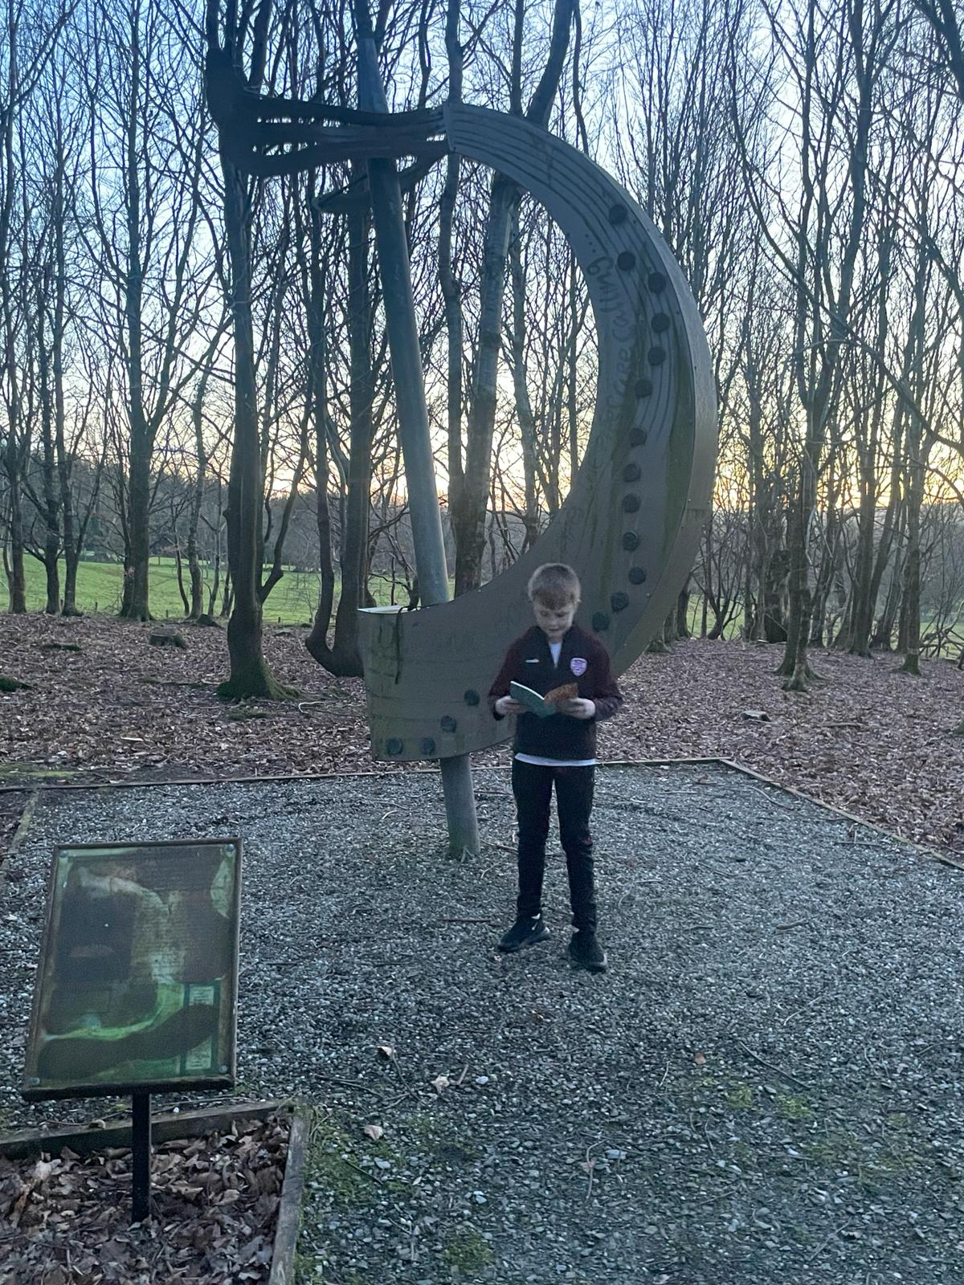
Where am I?

Slide 13
Where am I?

Slide 14
Where am I?

Slide 15
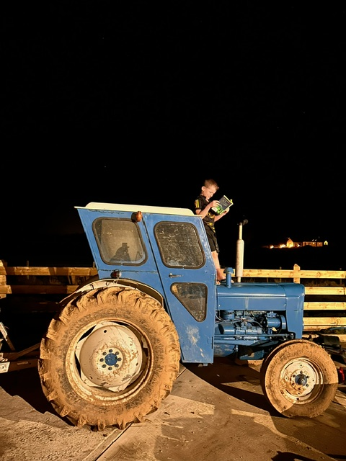
Where am I?

Slide 16
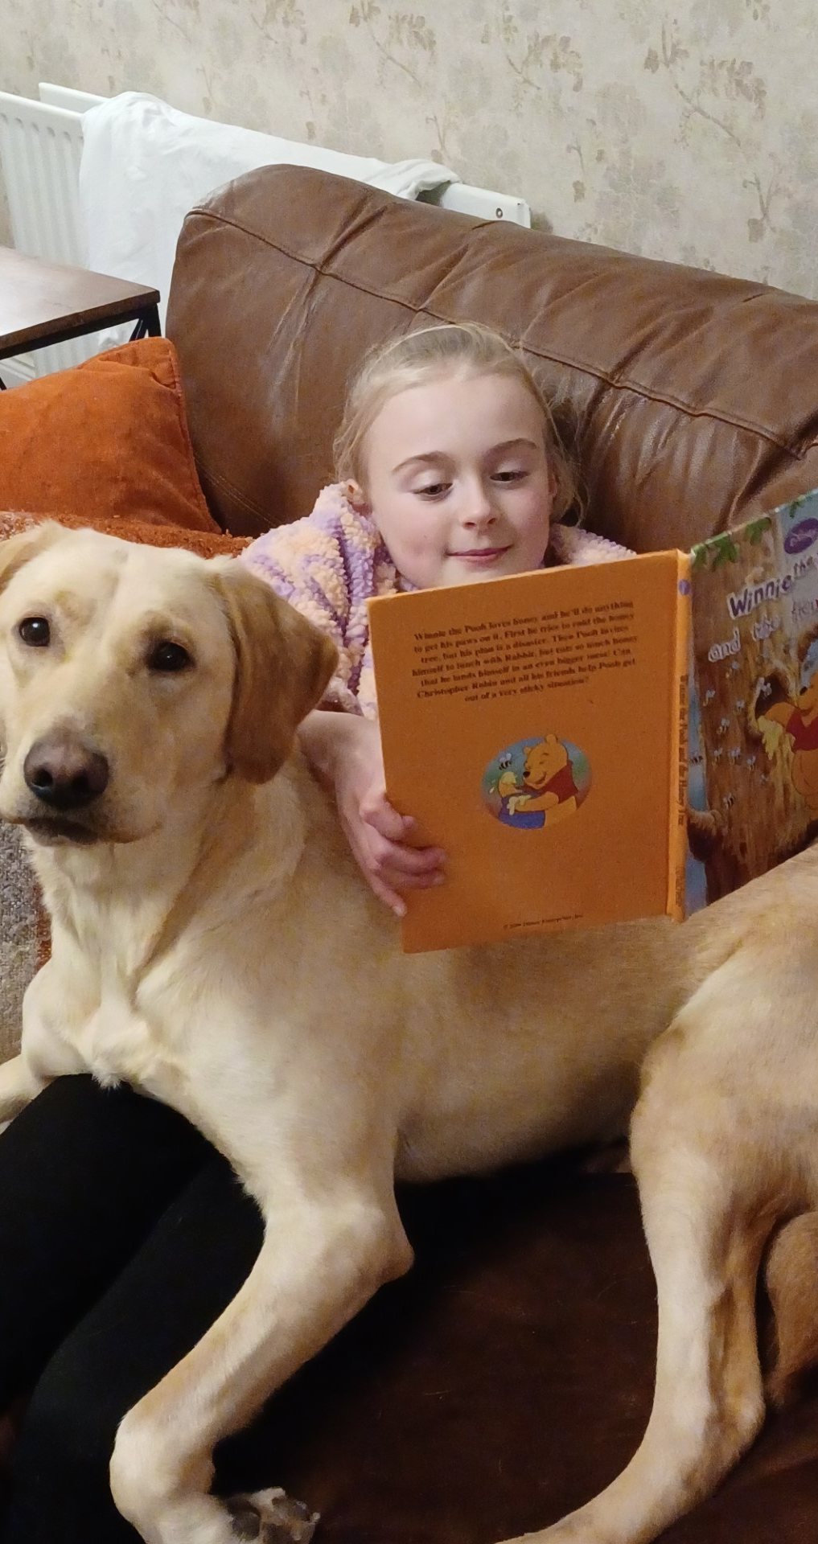
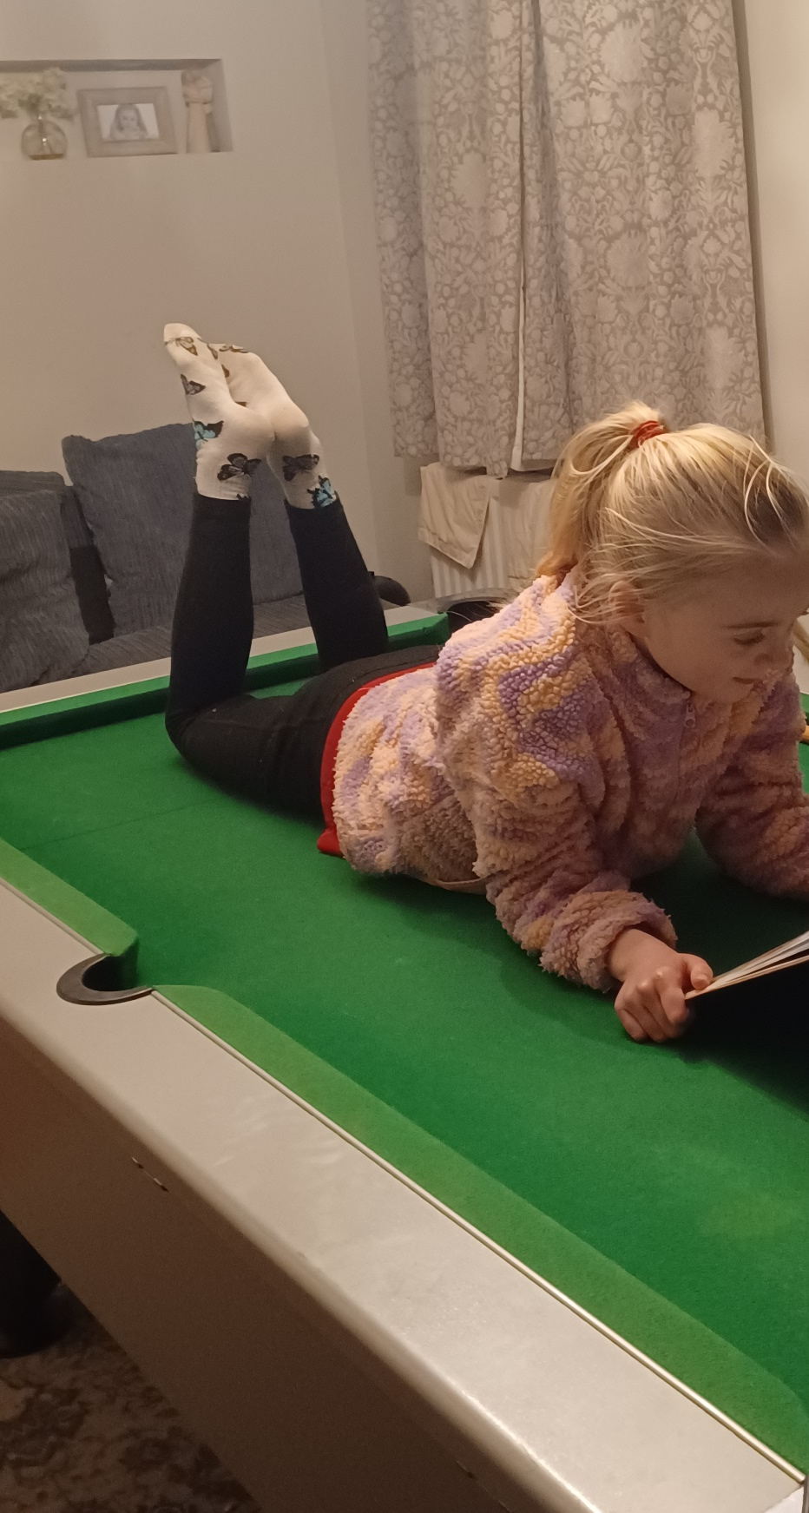
Where am I?

Slide 17
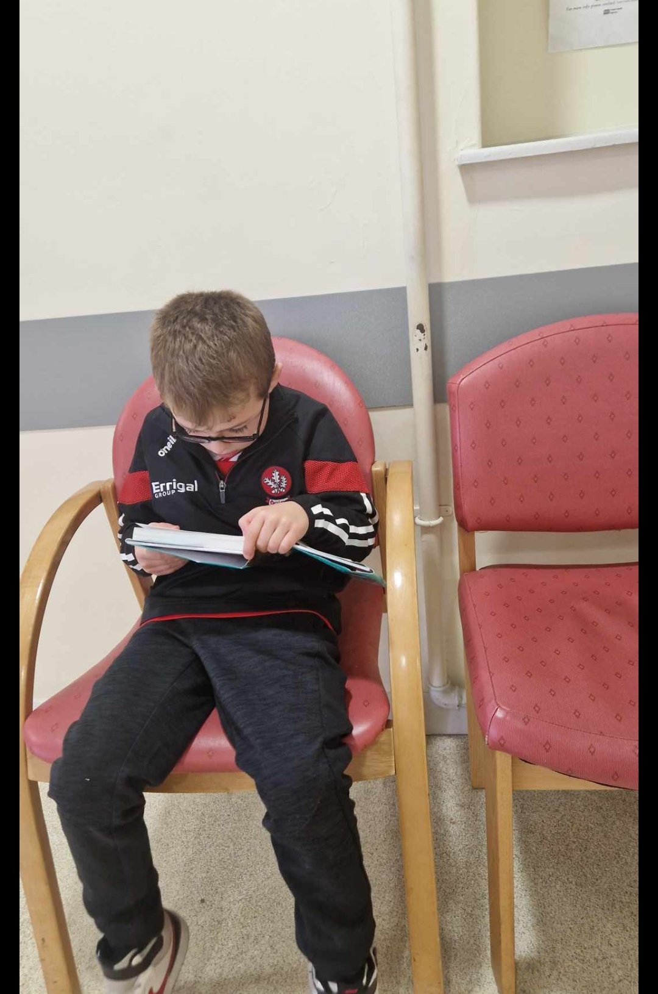
Where am I?

Slide 18
Where am I?

Slide 19
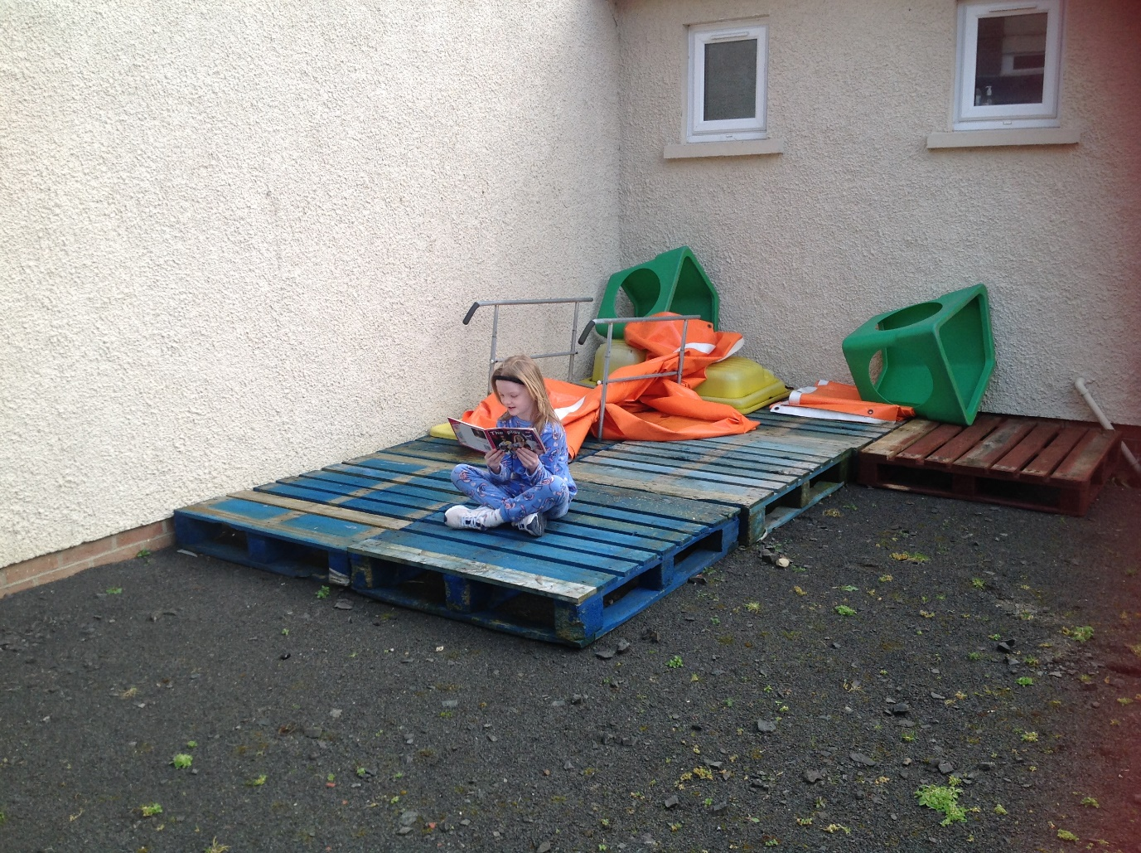
Where am I?

Slide 20
Where are we?

